Slide 1
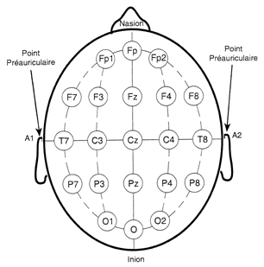
50%
Dual-cone
coil
4 cm
A
C
50%
50%
Cz
B
50%
Notes:
Measuring for TMS coil placement using the EEG 10-20 system
Take your tape measure and put “0” on the preauricular point of one ear (in front of the external canal) and stretch it over the head to the preauricular point of the other ear.
Divide that distance in half and make two marks on the scalp perpendicular to the tape, about 1cm, long at that point (A). That is the midline and should overlie the central sulcus of the brain. Be careful not to move the tape as you make the marks.
Take your tape measure and put “0” on the inion, a palpable bump at the base of the occipital skull. It may not be prominent and if not, palpate for the edge of the skull and place it there. Trick: If the subject is lying down and it is difficult/impossible to see the tape, place the end of the tape over your index finger and use touch to bring it to the base of the skull/inion.
Hold the “0” there and stretch the tape over the head to the nasion, the bump on the skull above the nose and between the eyes. The nasion is easily palpated on most people. Divide that distance in half and make another pair of marks perpendicular to the tape at that point on the scalp (B).
Remove the measuring tape and join the four marks to find the “Cz” or “vertex” location. (You will center the flat coil over this point with the handle held vertically.)
Using the tape measure again, stretch it from Cz to the nasion and mark 4cm up (anterior) from Cz for use with the dual-cone coil (C). For precision, you can check for center in the horizontal plane by measuring between the two preauricular points with the tape pulled through this mark. The dual-cone coil will be placed with this mark centered in indention between the coils. Such placement will put the junction between the coils directly over Cz. The handle will be perpendicular to the scalp and care should be taken to maintain the two coils adjacent to the ears.
It is recommended that two hands be used to hold the coil regardless of which type and it is often helpful to support the heavy cable over you shoulders.
Always warn the subject when the stimulus is coming.

